Slide 1

Employee Management System
A Relational Database Management System Using MySQL
Presented By:
Anwesha Panda

Slide 2
About Me :
Anwesha Panda
Background: B.Tech – CSE
Why Data Science? Interested in building data-driven, database-backed solutions to real-world business problems.
Work Experience: Fresher
LinkedIn: LinkedIn_URL
GitHub: GitHub_URL

Slide 3
Agenda
Objective of the Project
Problem Statement
Overview
ER Diagram
Q&A Slide
Challenges Faced
Conclusion

Slide 4
Objective :
To analyze employee data using SQL queries and database operations.
To understand employee distribution across departments and job roles.
To analyze salary, bonus, and payroll expenses.
To evaluate employee leaves and qualification records.
To generate meaningful findings that support better HR decision-making and workforce management.

Slide 5
Problem Statement :
Employee data is stored across multiple tables.
The data includes employee, department, salary, payroll, leave, and qualification details.
It is difficult to analyze all employee information manually.
SQL is used to organize, combine, and analyze the available data.
The goal is to generate accurate findings for better HR management.

Slide 6
Overview :
Technologies Used :
MySQL
SQL
MySQL Workbench
Key Features :
Employee & Job Management
Salary & Bonus Management
Payroll Management
Leave Management
Qualification Management

Slide 7
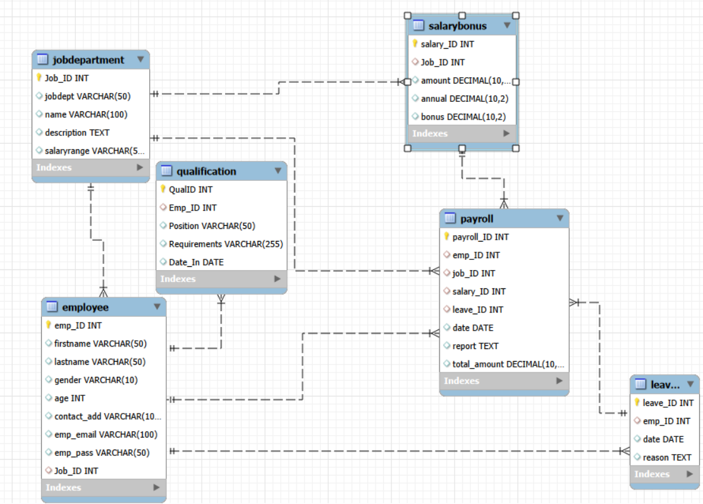
EER Diagram :

Slide 8
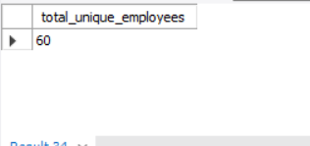
EMPLOYEE INSIGHTS:
Q. How many unique employees are currently in the system?
Query : Output :
Key Insights :
60 unique employees are currently present in the system.
DISTINCT emp_ID ensures each employee is counted only once.

Slide 9
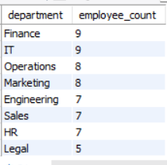
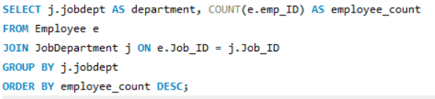
EMPLOYEE INSIGHTS:
Q. Which departments have the highest number of employees?
Query : Output :
Key Insights :
Finance and IT have the highest workforce with 9 employees each, while Operations and Marketing have 8 each.
Engineering, Sales, HR, and Legal have 7, 7, 7, and 5 employees respectively, showing a fairly balanced distribution.

Slide 10
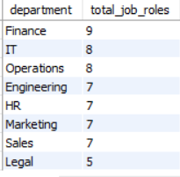

JOB ROLE AND DEPARTMENT ANALYSIS:
Q. How many different job roles exist in each department?
Query : Output :
Key Insights :
Finance has the highest number of job roles with 9 roles, followed by IT and Operations with 8 each.
Engineering, HR, Marketing, and Sales have 7 roles each, while Legal has the lowest with 5 roles.

Slide 11
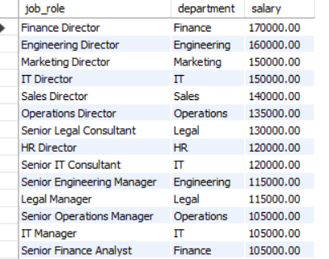

JOB ROLE AND DEPARTMENT ANALYSIS:
Q. Which job roles offer the highest salary?
Query : Output :
Key Insights :
Finance Director offers the highest salary at 170,000, followed by Engineering Director at 160,000.
Marketing Director and IT Director offer 150,000 each, while Sales Director ranks fifth at 140,000.

Slide 12
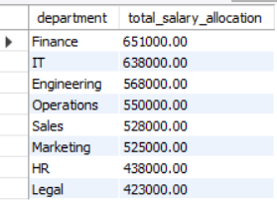
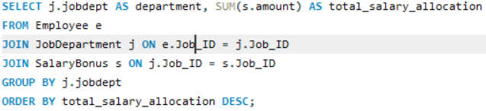
JOB ROLE AND DEPARTMENT ANALYSIS:
Q. Which departments have the highest total salary allocation?
Query : Output :
Key Insights :
Finance has the highest total salary allocation at 651,000, followed by IT at 638,000 and Engineering at 568,000.
Operations, Sales, and Marketing have 550,000, 528,000, and 525,000, while Legal and HR have the lowest allocations at 423,000 and 438,000.

Slide 13

QUALIFICATION AND SKILLS ANALYSIS:
Q. How many employees have at least one qualification listed?
Query : Output :
Key Insights :
All 60 employees have at least one qualification listed in the system.
This means 100% of the employees have qualification records.

Slide 14
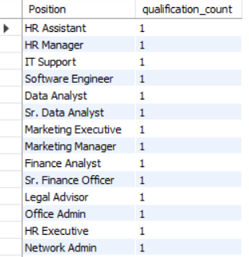

QUALIFICATION AND SKILLS ANALYSIS:
Q. Which positions require the most qualifications?
Query : Output :
Key Insights :
All listed positions have 1 qualification each, so no position requires more qualifications than another.
The qualification requirement is therefore uniform across all listed positions.

Slide 15
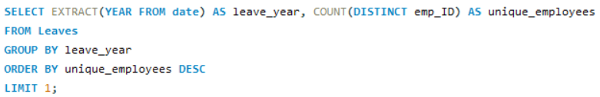

LEAVE AND ABSENCE PATTERNS:
Q. Which year had the most employees taking leaves?
Query : Output :
Key Insights :
2024 had the most employees taking leaves, with 60 unique employees.
All 60 employees had at least one leave record in 2024, meaning 100% of employees had leave records.

Slide 16


LEAVE AND ABSENCE PATTERNS:
Q. What is the total number of leave days taken company-wide?
Query : Output :
Key Insights :
The company recorded 60 total leave days, averaging 1 leave day per employee.
Overall, leave usage is uniform across the company.

Slide 17
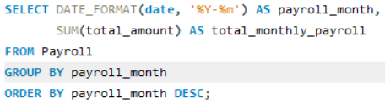

PAYROLL AND COMPENSATION ANALYSIS:
Q. What is the total monthly payroll processed?
Query : Output :
Key Insights :
In April 2024, the company processed a total monthly payroll of 2,778,000, averaging 46,300 per employee.
This provides a useful baseline for monthly payroll budgeting and workforce cost analysis.

Slide 18


PAYROLL AND COMPENSATION ANALYSIS:
Q. What is the average value of total_amount after considering leave deductions?
Query : Output :
Key Insights :
The average net payroll after leave deductions is 46,300 per employee.
This represents the company’s average effective payroll cost for its 60 employees.

Slide 19
Challenges Faced :
Integrating and connecting data from multiple employee management tables.
Writing complex SQL queries using joins, aggregations, and grouping.
Avoiding duplicate records while calculating salary, bonus, and leave metrics.
Handling data consistency and missing values across different tables.
Ensuring the accuracy of calculated results and validating them against the source data.

Slide 20
Conclusion :
The Employee Management project successfully used SQL to analyze employee, department, salary, payroll, leave, and qualification data. The analysis provided useful findings about workforce distribution, salary and bonus allocation, payroll expenses, and leave patterns. These findings can help management make better decisions related to employee planning, compensation, payroll management, and workforce analysis.

Slide 21

THANK YOU

